Slide 1
Project Title :
Oil Price Prediction
Name of the Team | P_269 -> Group 4
Mentor | Aishwarya Mate
Team Members | RUCHI HARDAHA RISHI KANT GUPTA VIDYA S THILAK RAJU S MINAL DHARAMDIP INGLE AKSHAY SASANE

Slide 2

Business Objective:
Develop a forecasting model to accurately predict the future prices of crude oil based on historical data, market trends, and other relevant variables. The model should consider the impact of various factors such as geopolitical events, economic indicators, supply and demand dynamics, and changes in government policies. The goal of this model is to provide reliable and accurate forecasts of crude oil prices, enabling stakeholders in the energy industry to make informed decisions regarding production, investment, trading, and risk management.

Slide 3

Project Architecture/ Project Flow

Slide 4
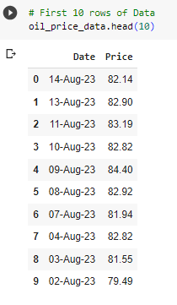

Data Set Details
Data Set has 6054 rows and 2 columns: Date & Price.
Data has daily records except Saturdays and Sundays.

Slide 5
Exploratory Data Analysis
Steps Performed in EDA
Dataset summarization
Check for duplicate values
Conversion of data types to datetime
Setting Index
Check for missing values and Imputations
Outlier detection and removal using capping method
Visualization of the data

Slide 6
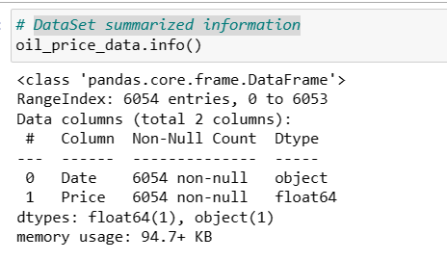
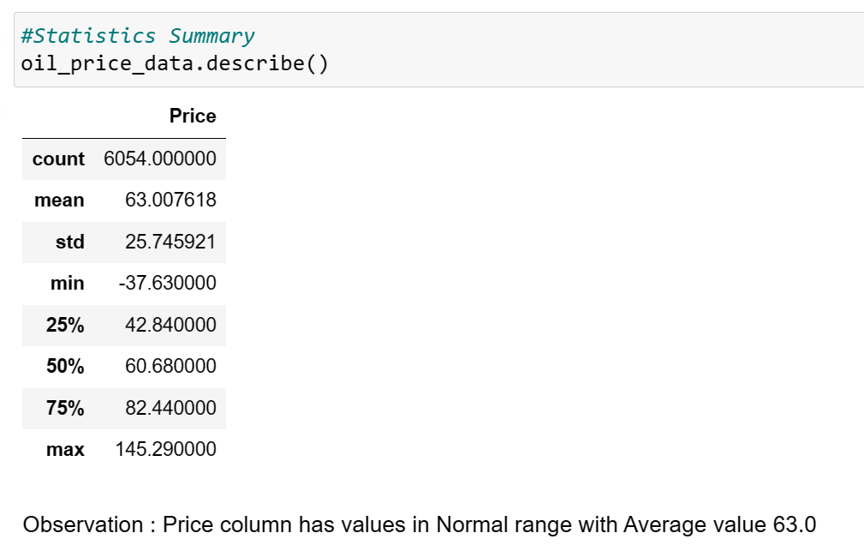
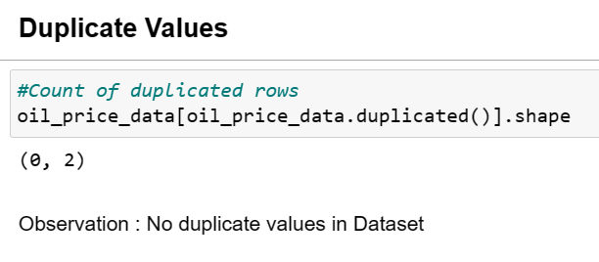
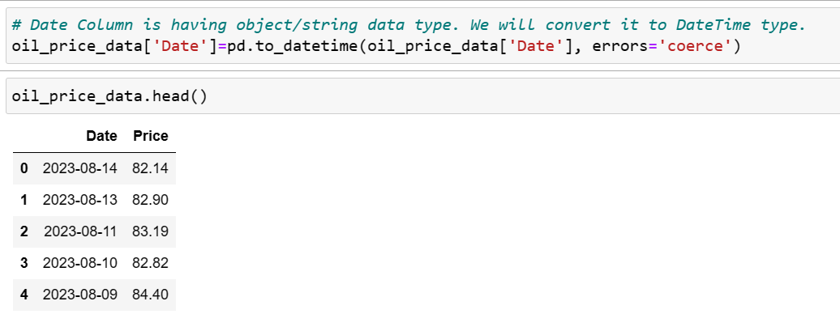
Dataset summarization​
Basic information of the data is gathered such as no of rows and columns and datatype of the dataset. Mean, minimum and maximum data is observed.
Check for duplicate values
Duplicated records are checked in the dataset.
Conversion of datatypes to datetime
Date Column is having object/string data type. We will convert it to DateTime type

Slide 7
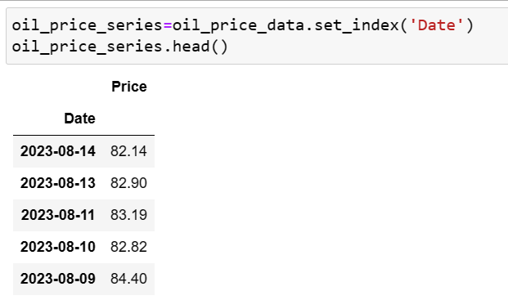
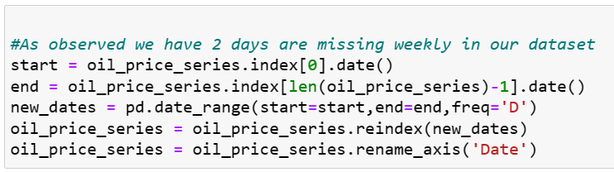
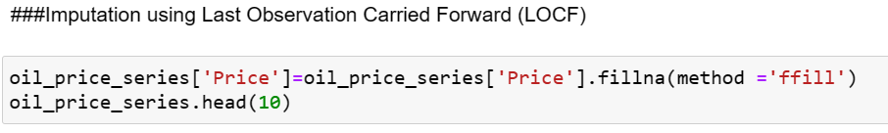
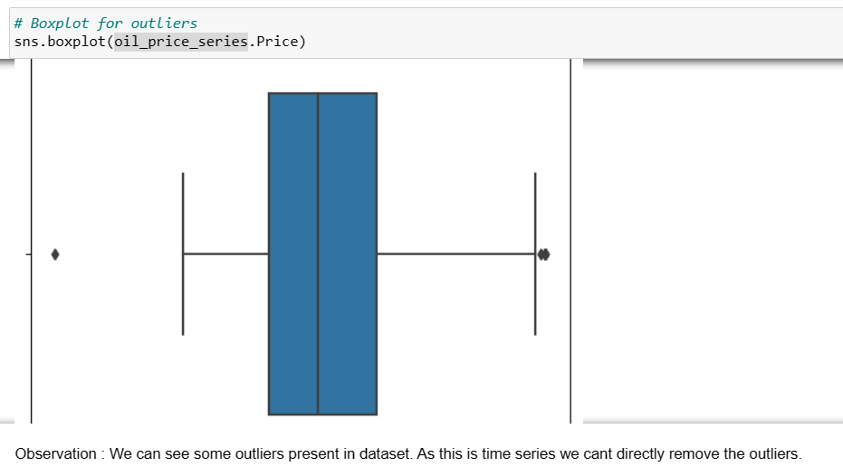
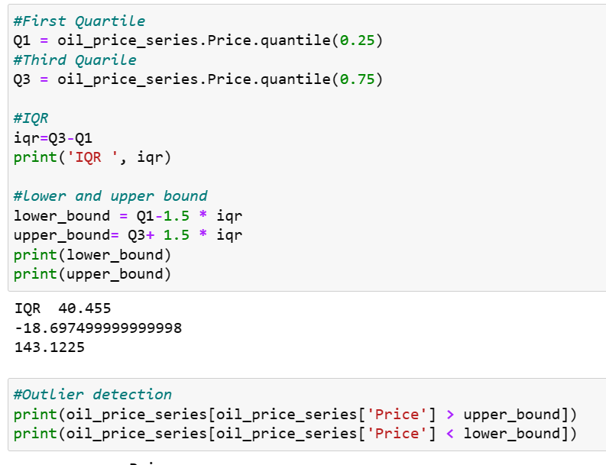
Setting Index
As this is a Time Series Data set, We will set Date column as index
Check for missing values and Imputations
Missing values and missing dates are checked and corrections is performed using forward fill.
Outlier detection and removal using capping method
Boxplot is used for outlier detection. Capping method is used to deal with the outliers present in the dataset

Slide 8
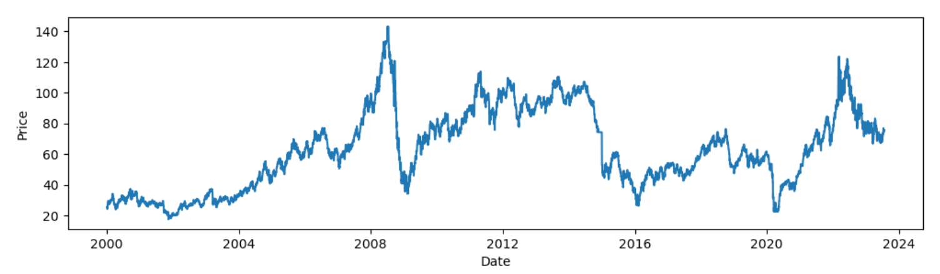
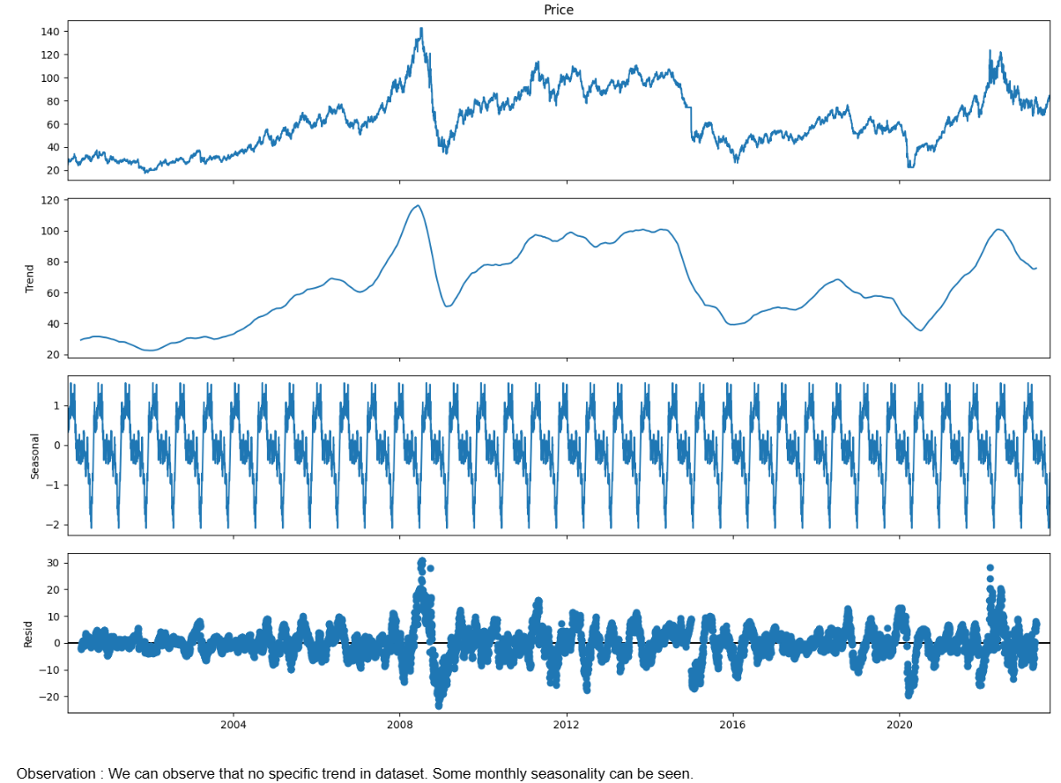
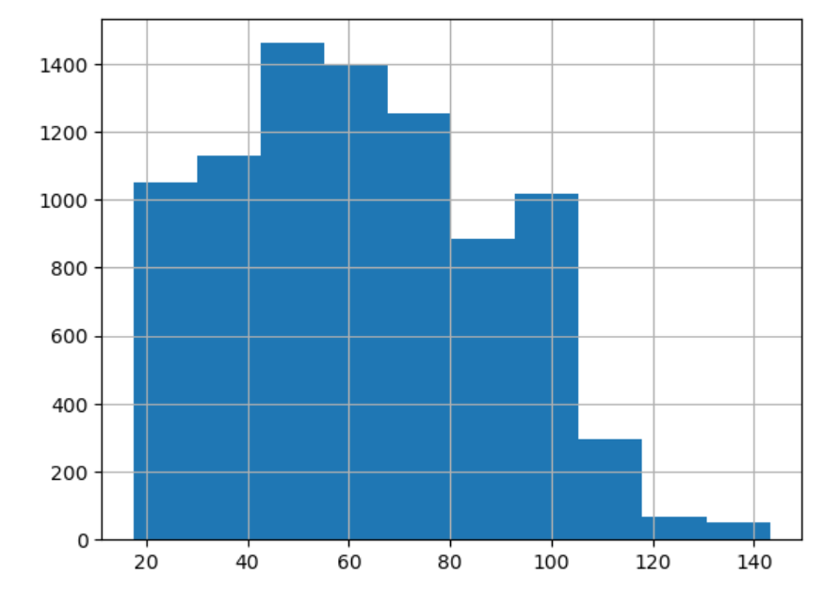
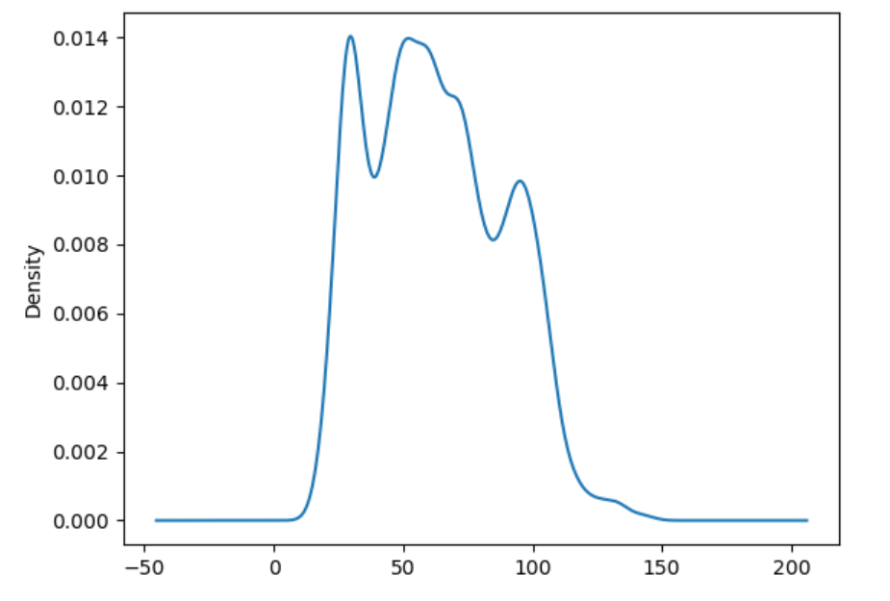
Visualizations performed on the dataset
Line Plot
Histogram Plot
Density Plot
Box Plot
Lag Plot
Moving Averages Plot
Time Series Decomposition Plot
Auto correlation Plot

Slide 9
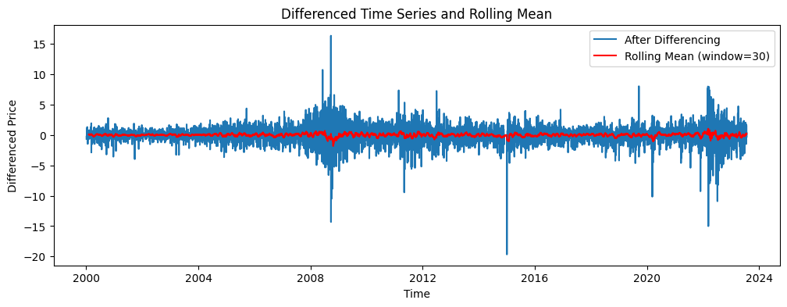
MODEL BUILDING
By Differencing Method, the p-value of data becomes less than 0.05 and when it gets less than the same, our data becomes stationary and we checked the same by Adfuller Test.
Then by sequential method, data is split into train & test.
RMSE - Root Mean Squared Error
def RMSE(pred, org):
MSE = np.square(np.subtract(org, pred)).mean()
RMSE = np.sqrt(MSE)
return rmse
Where we will get the minimum RMSE value we will build the final model on the same

Slide 10
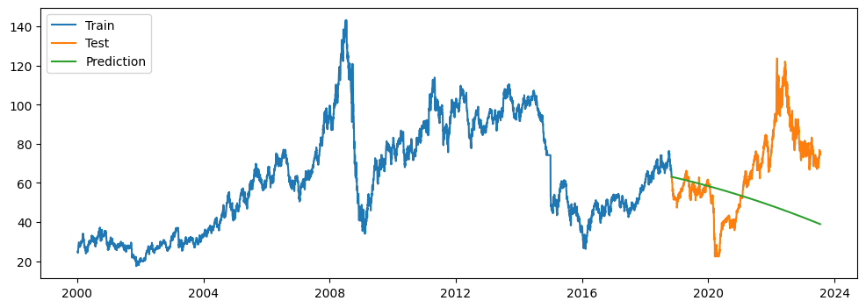
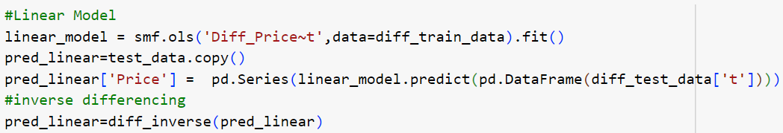
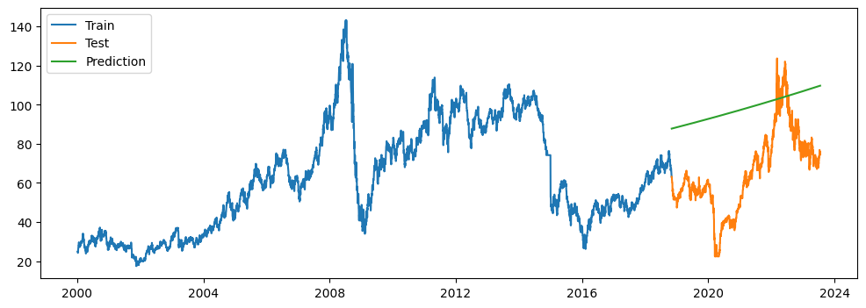
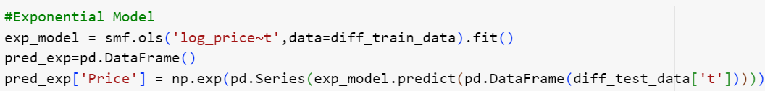
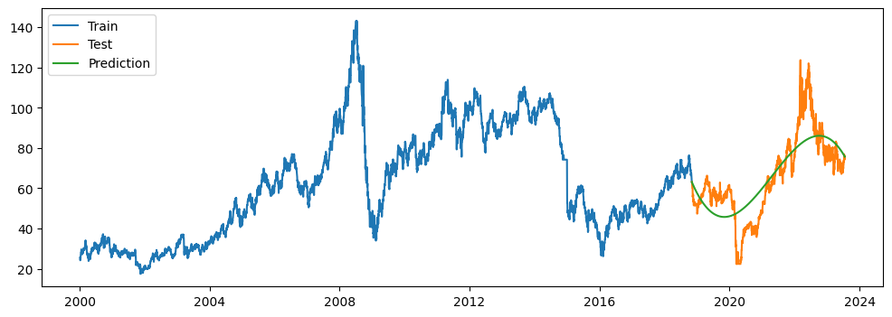
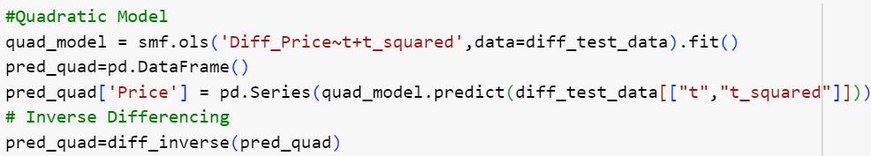
MODEL BASED FORECASTING

Slide 11
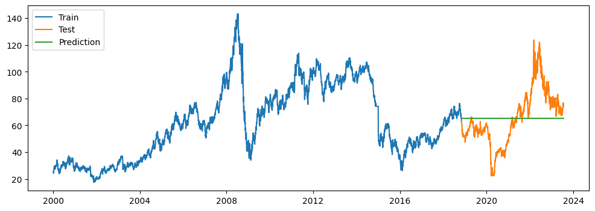
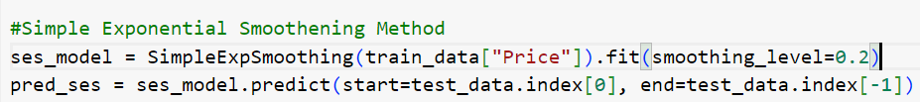
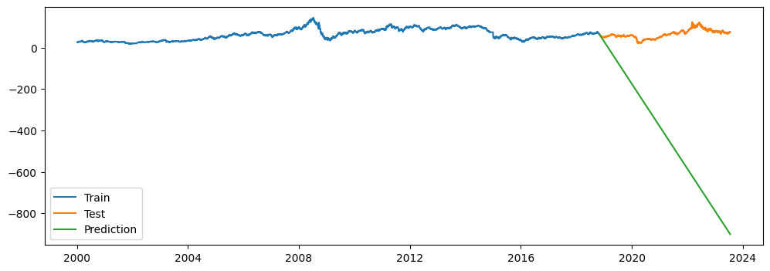
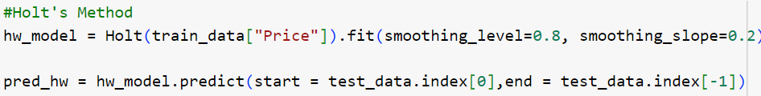
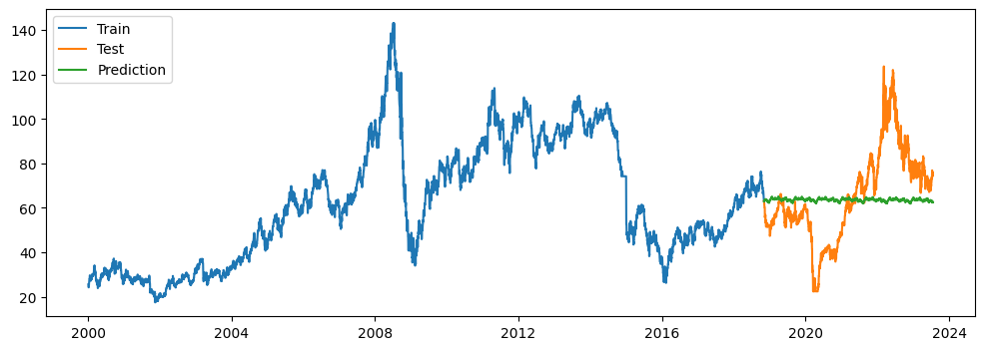

DATA DRIVEN MODELS

Slide 12
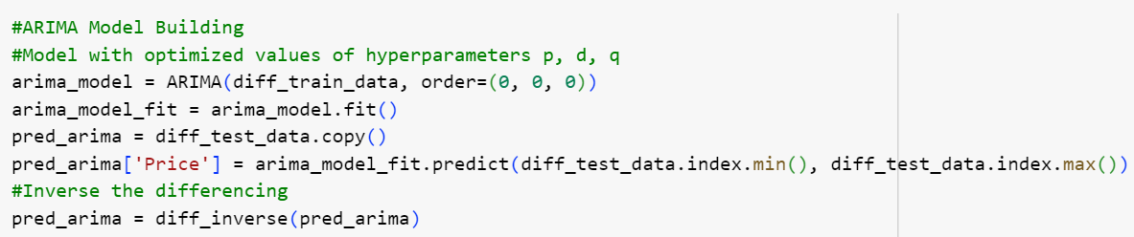

AUTOREGRESSIVE INTEGRATED MOVING AVERAGE (ARIMA) MODEL

Slide 13
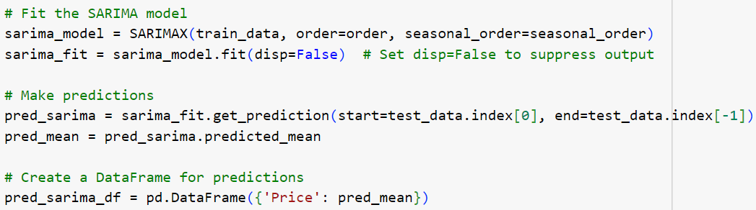
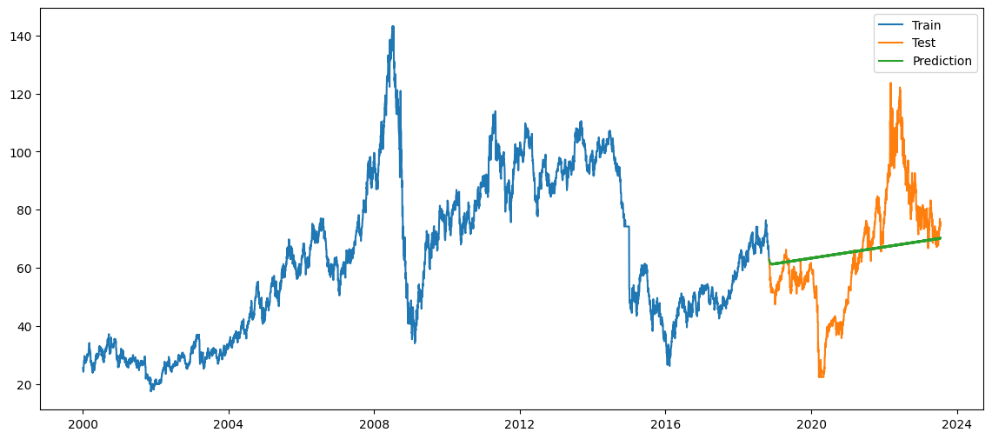
SEASONAL AUTOREGRESSIVE INTEGRATED MOVING AVERAGE (SARIMA) MODEL

Slide 14
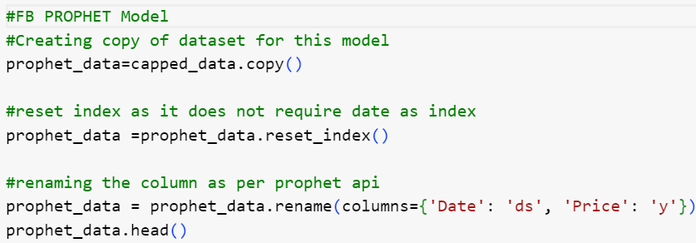
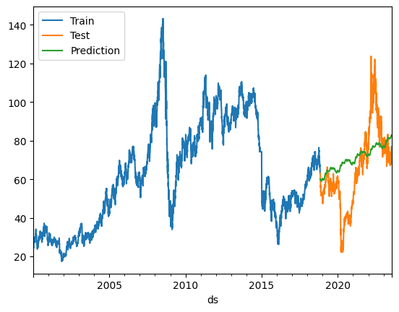
FB PROPHET MODEL

Slide 15
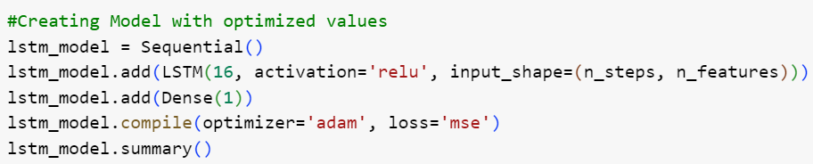
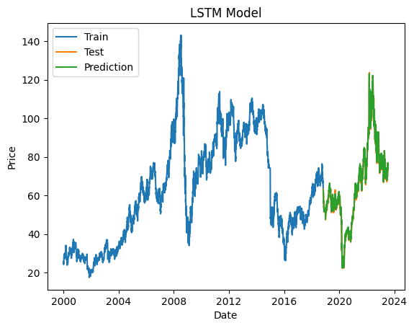
LONG SHORT TERM MEMORY(LSTM) MODEL

Slide 16
Model Comparison
Sr. No. | Method | MAPE | RMSE
0 | LSTM Model | 2.036772 | 1.998515
1 | Quadratic Model | 17.764719 | 11.911926
2 | FB Prophet Model | 27.708343 | 18.084728
3 | Seasonal ARIMA Model | 26.510467 | 18.887542
4 | ARIMA Model | 27.843029 | 18.961463
5 | Holt's Winter Exponential Smoothing with Multiplacative seasonality & Additive Trend | 28.234913 | 19.859294
6 | Simple Exponential Smoothing | 29.731985 | 20.491819
7 | Holt's Winter's Exponential Smoothing with Additive seasonality & Additive Trend | 29.014476 | 20.647820
8 | Linear Model | 34.228209 | 28.991709
9 | Exponential Model | 66.613889 | 36.879873
10 | Holt's Method | 721.161062 | 566.208259

Slide 17
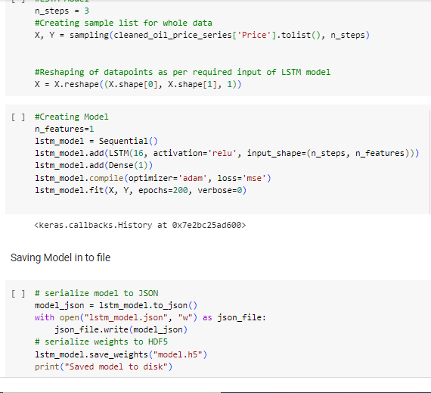
Final Model Building
LSTM Model
Trained the model with whole data
Saved the model in Json file

Slide 18
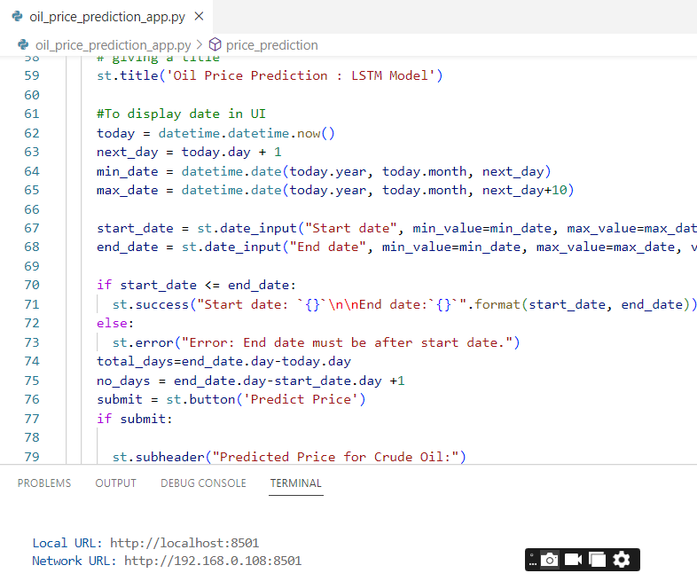
Deployment
Created .py file for deployment
Loaded model from Json file
Streamlet Library for UI elements

Slide 19
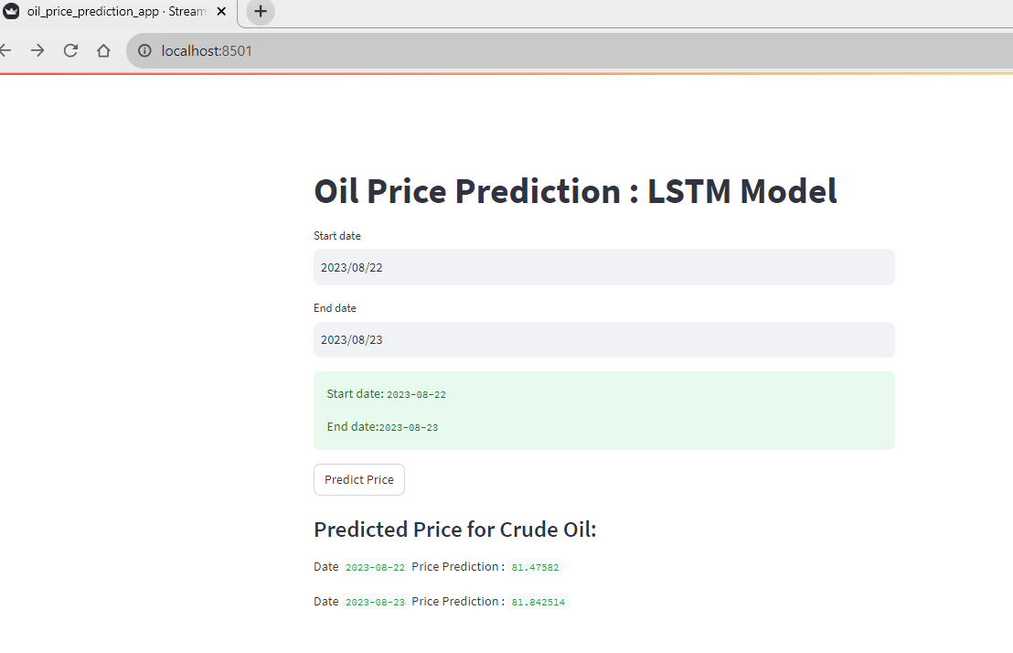
Oil Price Prediction Application

Slide 20
Thank You

